Slide 1
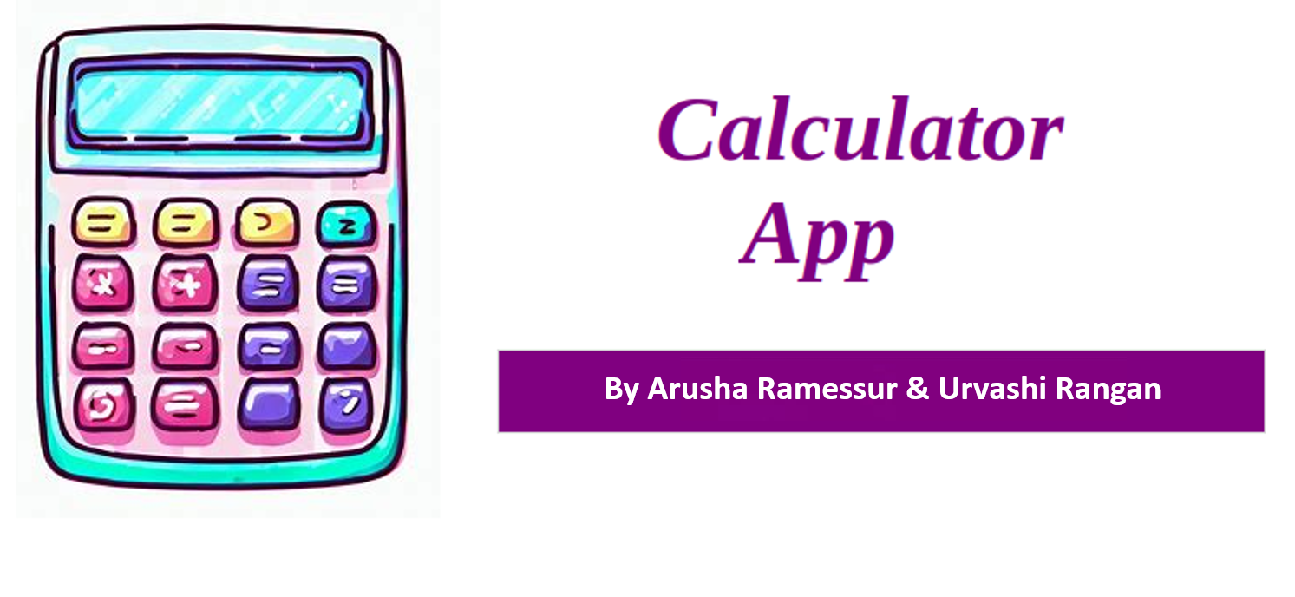

Slide 2
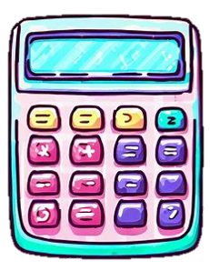
PURPOSE OF THIS PROJECT
Our calculator application offers a range of functionalities such as doing simple and complex calculations, calculating areas, converting units & numbers, and solving quadratic equations to assist users in different scenarios, making it an all-in-one solution.
This project aims to provide students and professionals with a functional calculator that performs all sorts of calculations quickly and accurately

Slide 3
PROBLEM STATEMENTS
Convenience: By providing multiple functionalities in a single application, users can access them without the need to switch between different platforms.
Efficiency: Users can save time and effort by utilizing the functions available within the application.
User-Friendly Interface: By creating an intuitive and user-friendly interface. Our goal is to ensure that users, regardless of their technical expertise, can easily navigate and utilize the features of our application.

Slide 4
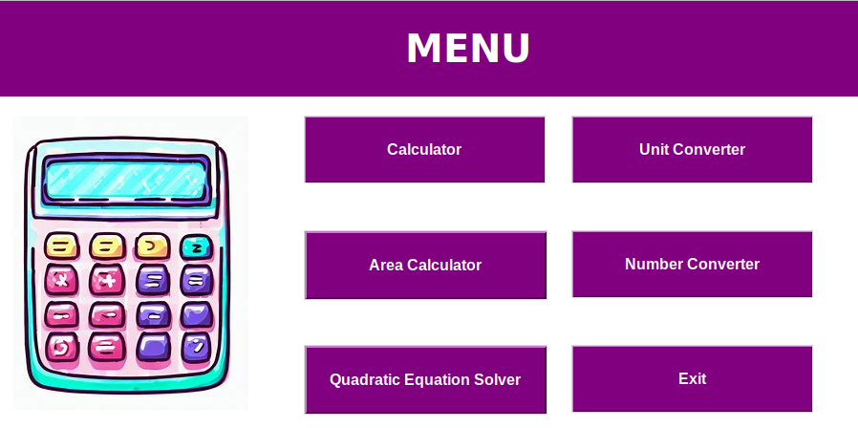
FEATURES PRESENT IN OUR APPLICATION

Slide 5
TECHNOLOGIES, FRAMEWORK AND LIBRARY USED
Threading: Threading is a Python module that provides a way to run multiple threads (smaller units of execution) concurrently within a single program. It is used in the calculator, unit converter, and number converter components to handle concurrent operations efficiently.
Tkinter: It is a standard Python library for creating graphical user interfaces (GUI). It is used to build the user interface components of the application, such as buttons, labels, and entry fields.
Math Library: It is a built-in Python library that provides various mathematical functions and constants. It is utilized in the scientific calculator component to perform calculations involving trigonometric functions, logarithms, exponentiation, and more.

Slide 6
CODE HIGHLIGHTS

Slide 7
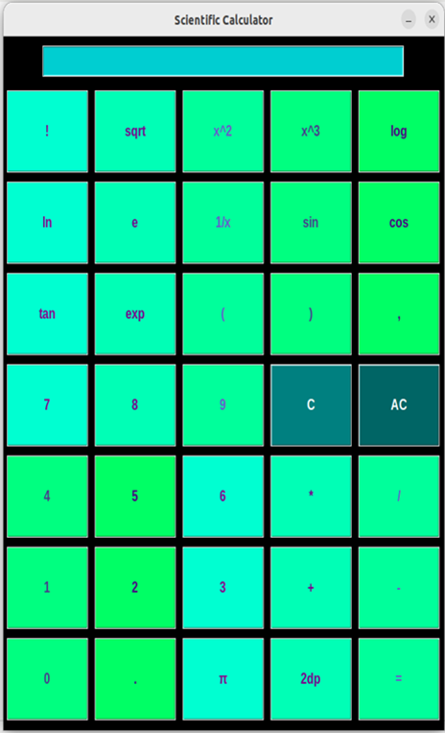
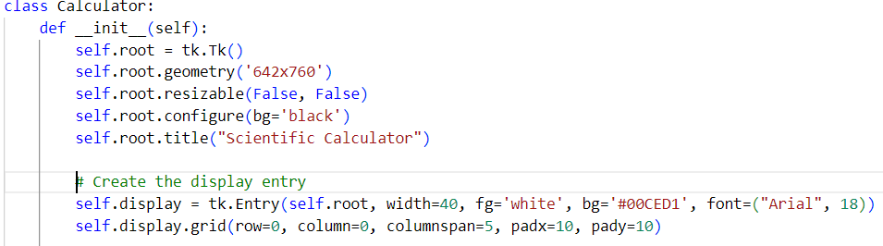
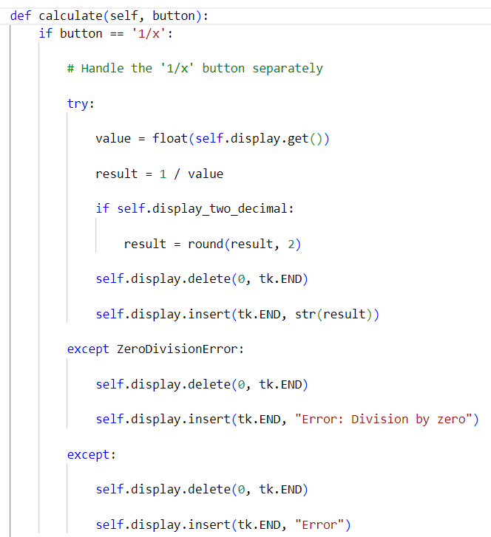
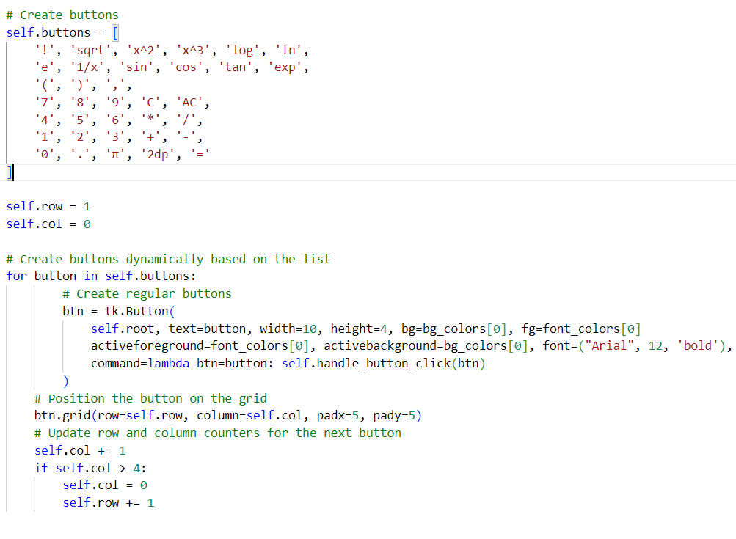
SCIENTIFIC CALCULATOR
1: A class called "Calculator" that implements GUI for the scientific calculator using Tkinter. The constructor initializes the calculator window with specific dimensions, background color, and title.
3: the "Calculate" method performs the corresponding mathematical operation upon a button click, handling special cases like division by zero or invalid expressions.
2: The class includes a list of buttons representing various mathematical operations and special functions. Buttons are dynamically created based on this list, with distinct color schemes. The GUI arranges buttons in a grid layout using row and column counters.

Slide 8
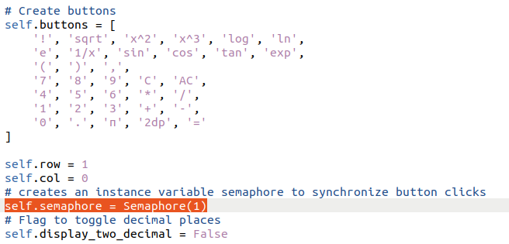
SEMAPHORE THREADING IN CALCULATOR
STEP 1: creates an instance variable semaphore to synchronize button clicks

Slide 9
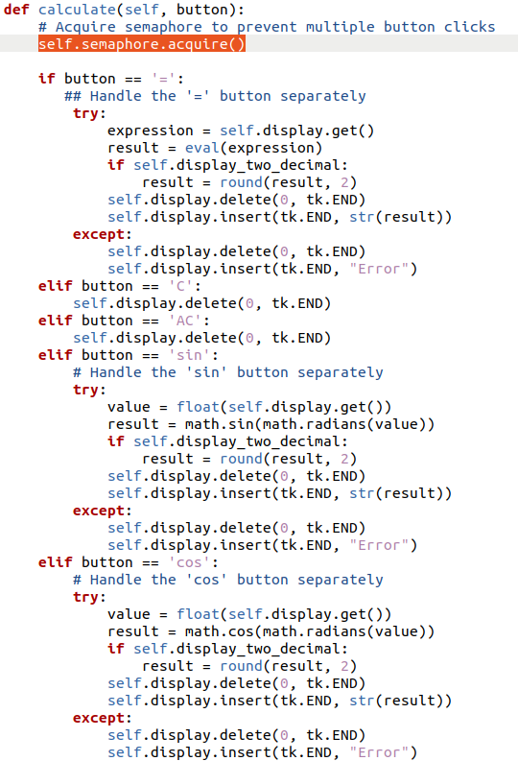
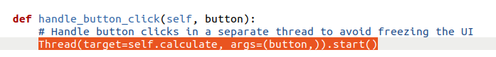
STEP 2: Handle button clicks in a separate thread to avoid freezing the UI
STEP 3: Acquire semaphore to prevent multiple button clicks
STEP 4: Release semaphore to allow next button click

Slide 10
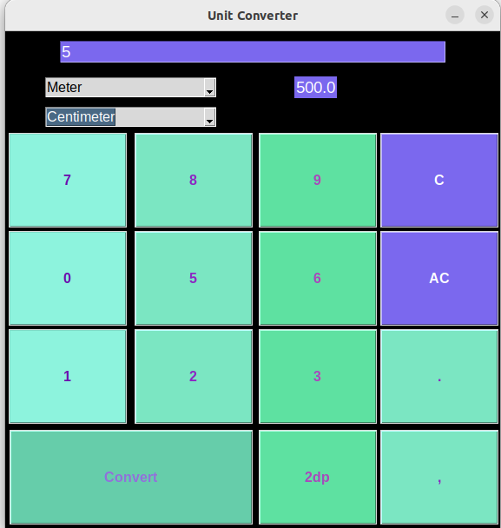
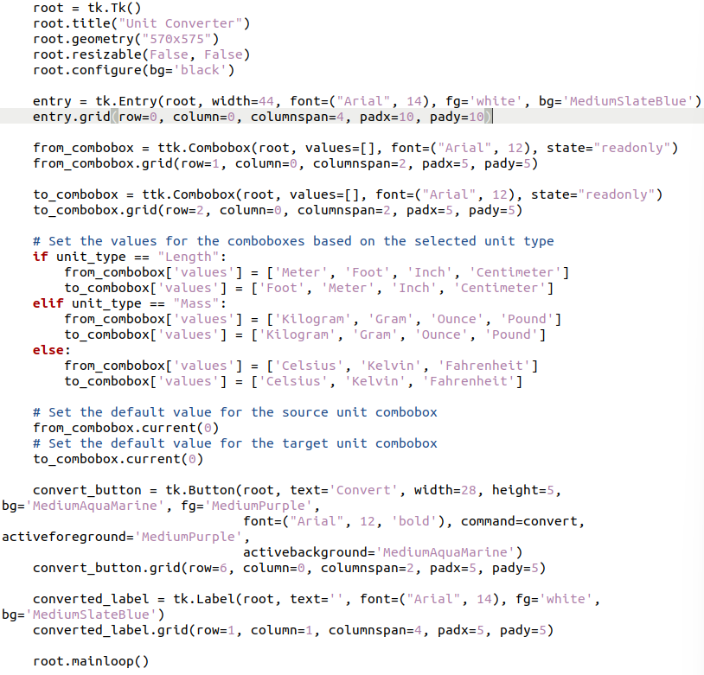
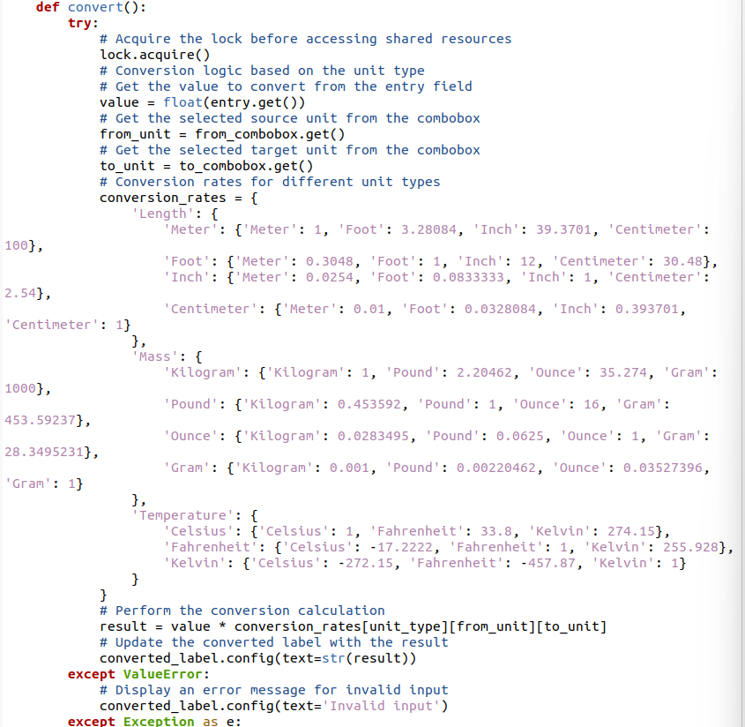
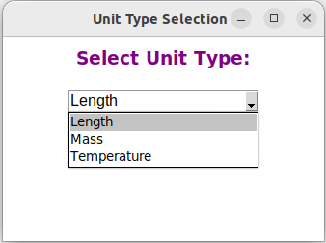
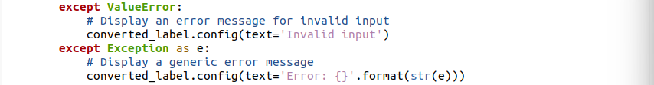
UNIT CONVERTER
1: The unit_converter function sets up a new window for unit conversion. It includes an entry field to input the value for conversion and several buttons representing digits, a decimal point, and options to clear the entry or round the result to two decimal places. The available unit types in the comboboxes are dynamically populated based on the selected unit type from the select_unit_type function.
2: The convert function is called when the Convert button is clicked, performing the actual unit conversion based on the selected source and target units. It uses a dictionary containing conversion rates for different unit types. If the input value or the chosen units are invalid, error messages are displayed.

Slide 11
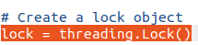
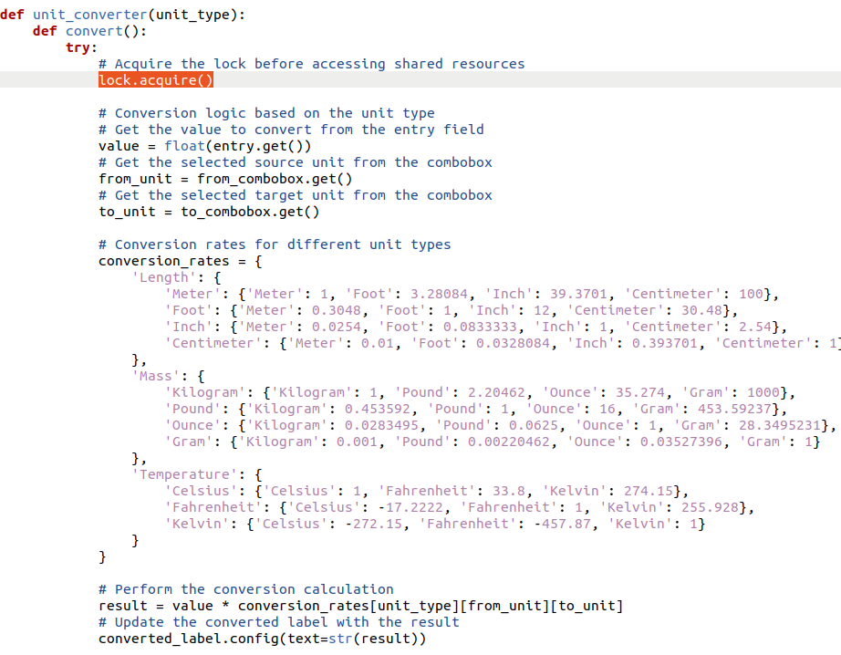
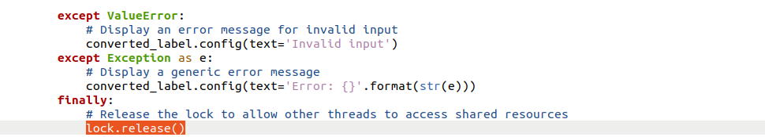
LOCK THREADING IN UNIT CONVERTOR
STEP 1:
STEP 2 & 3:

Slide 12
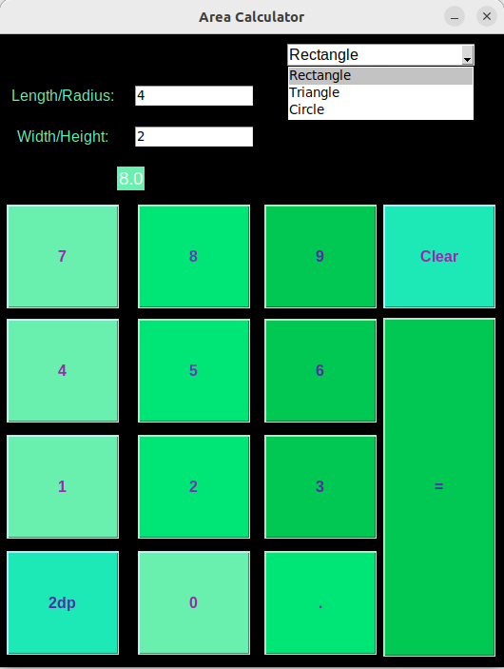
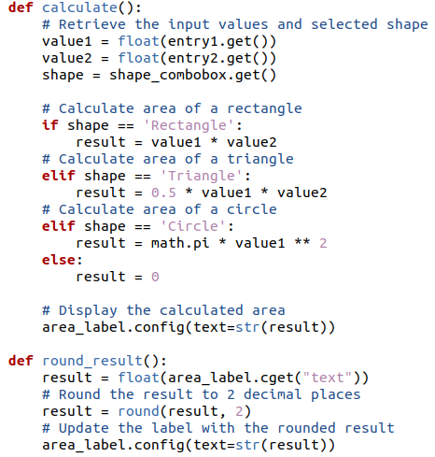
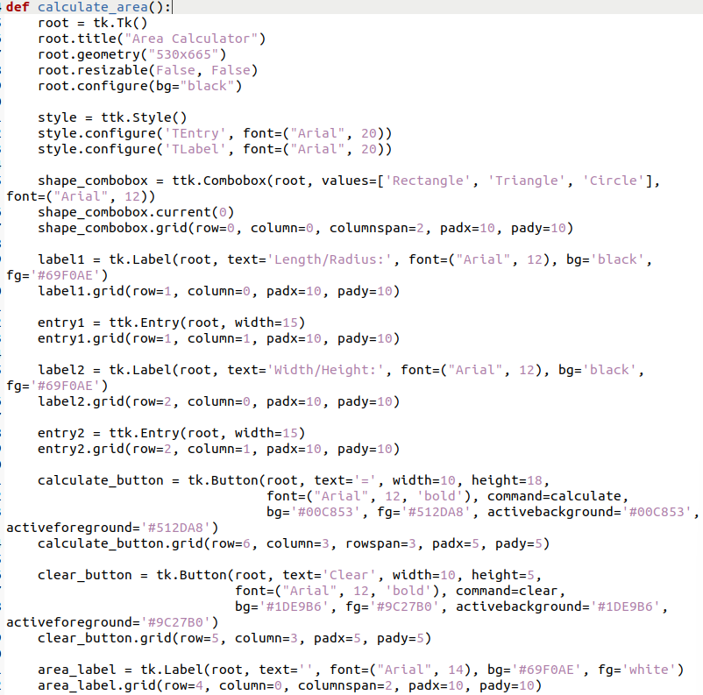
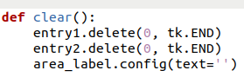
AREA CALCULATOR
2: The calculate function calculates the area based on the selected shape and the input dimensions when the = button is triggered and displays the result in the area_label on the GUI. The round_result function rounds the calculated area to two decimal places when the 2dp button is clicked. The clear function clears the input fields and the area result label.
1: The function calculate_area defines GUI for the area calculator using Tkinter. It consists of a dropdown menu to select the shape for which the area needs to be calculated. The GUI is styled using ttk.Style with a specific font, and the window size is set. Two entry fields allow users to input the required dimensions for the chosen shape.

Slide 13
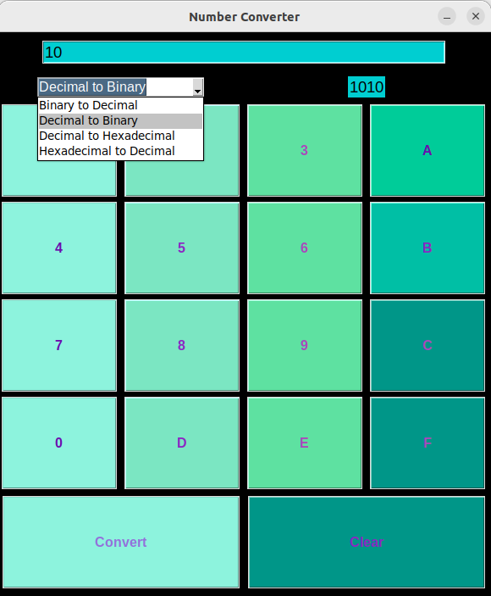
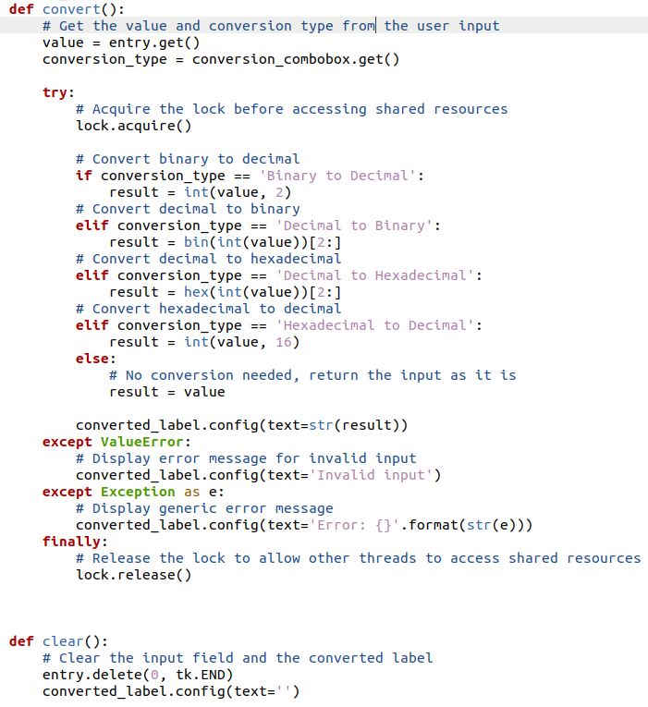
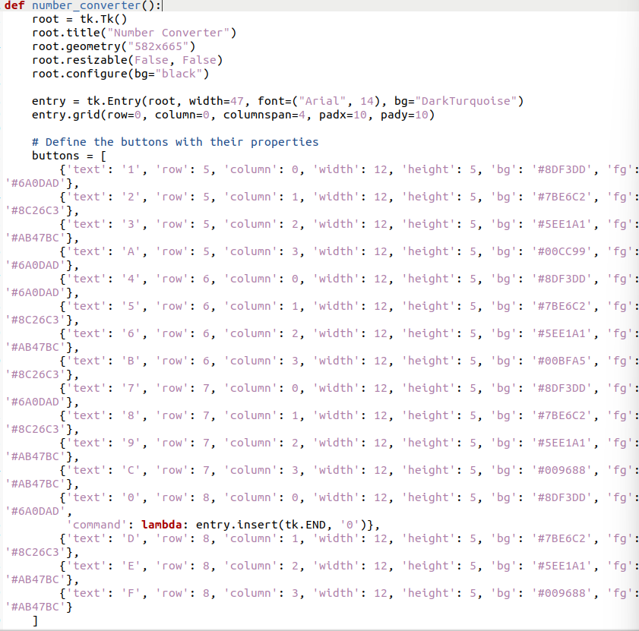
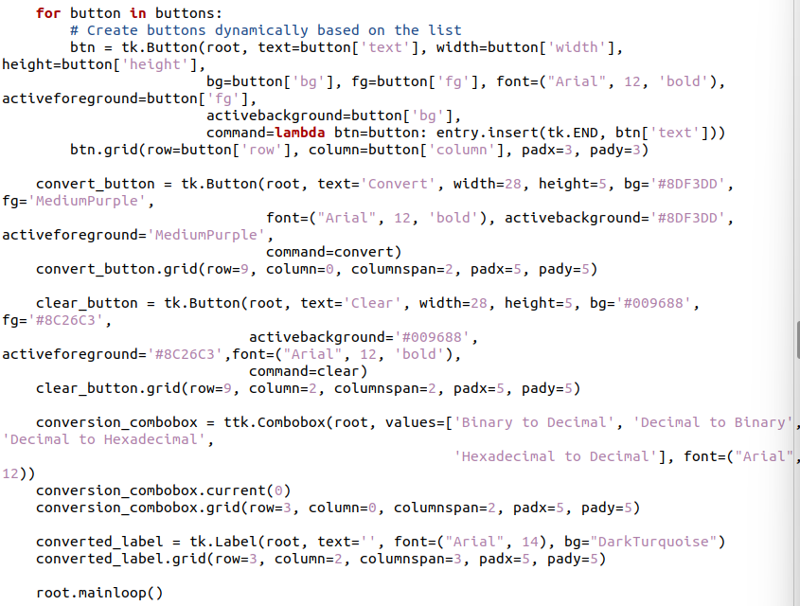
NUMBER CONVERTER
2: The convert function handles the number conversion based on user input, extracting the value and chosen conversion type from the input fields, and performing the appropriate conversion using if-else statements. The result is then displayed in the converted_label on the GUI.
1: The number_converter function is the main entry point for the number converter application, responsible for setting up the GUI using Tkinter widgets. The GUI dynamically creates buttons for numbers and letters, triggered by user clicks, as well as a combobox for selecting conversion types. Two buttons, convert and clear, trigger the conversion and clearing functions, respectively.

Slide 14
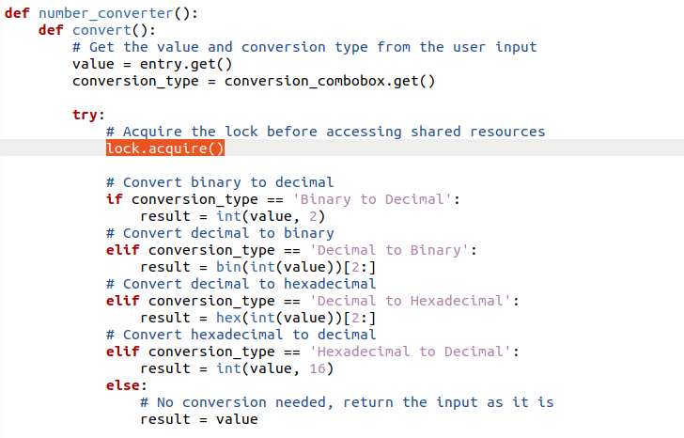
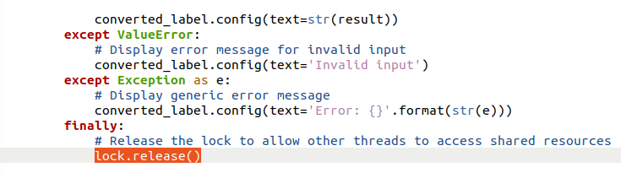
LOCK THREADING IN NUMBER CONVERTOR

Slide 15
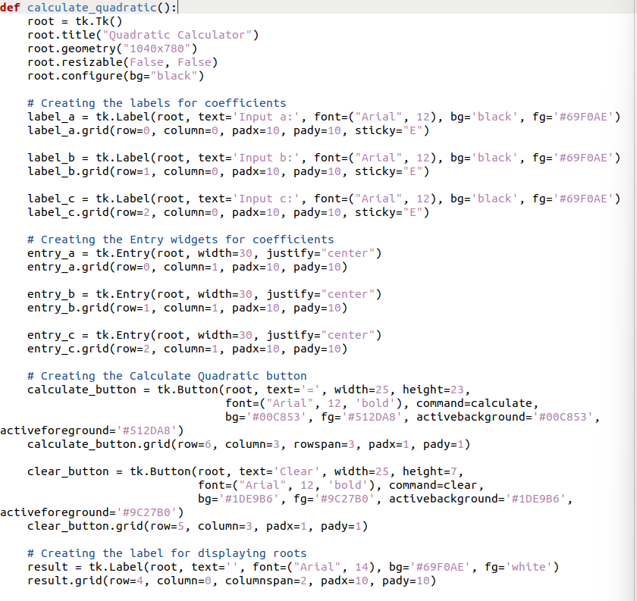
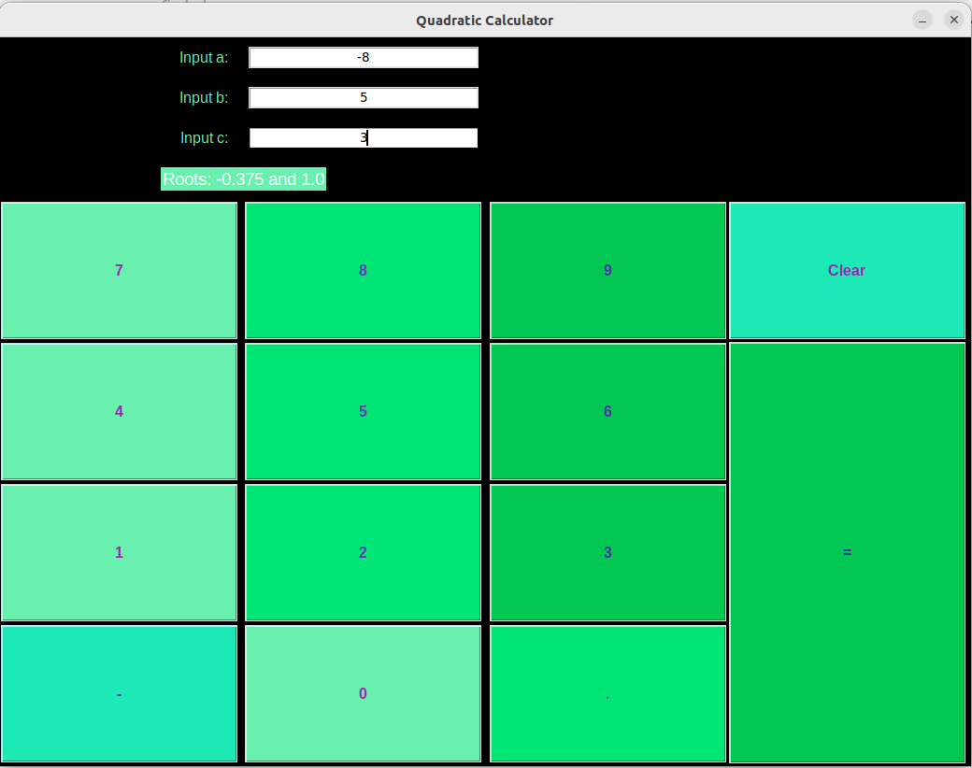
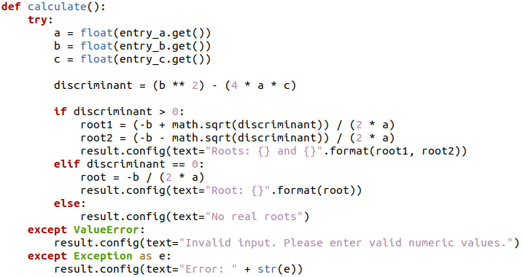
QUADRATIC EQUATION SOLVER
1: The calculate_quadratic function defines the quadratic equation solver application with a GUI using Tkinter. It consists of labels and entry fields for the coefficients, numerical buttons and a calculate_button to trigger the calculation. The number buttons are created dynamically using a loop, and their clicks insert the corresponding value into the active entry field.
2: The calculate function is responsible for processing the input coefficients, calculating the discriminant, and determining the roots. It displays the results in the result label on the GUI.

Slide 16

ANY QUESTIONS

Slide 17
THANK YOU

